Slide 1
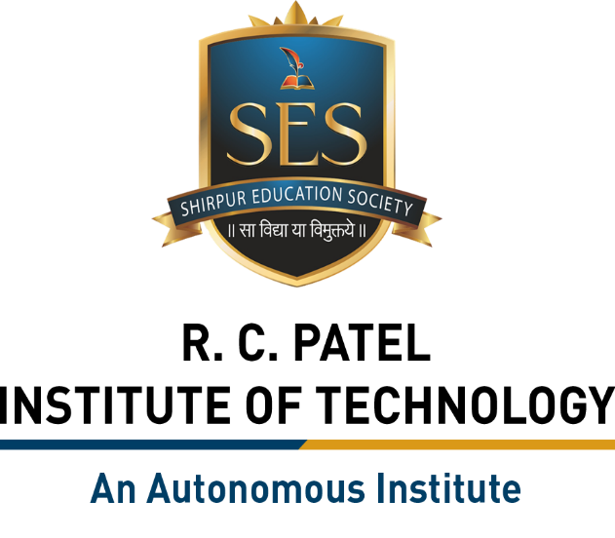
Semester Project – I
“AI VOICE ASSISTANCE”
By
Ashwini Aaba Mali (251108067 & 56)
Vedant Rohidas Koli (251108115 & 96)
Diksha Rajesh Jawanjal (251108028 & 25)
Prasanna Chandrakant Mali (251108105 & 87)
Under the Guidance of
Prof. Sandip S. Hire
Department of Artificial Intelligence and Data Science
The Shirpur Education Society’s
R. C. Patel Institute of Technology, Shirpur - 425405.
[2026-27]

Slide 2

Outline
Project Title & Team Introduction
Domain Overview
Problem Statement
Literature Survey
Comparative Analysis
Proposed Methodology
Software and Hardware Requirements
Timeline / Gantt Chart
Conclusion and Future Scope
References

Slide 3
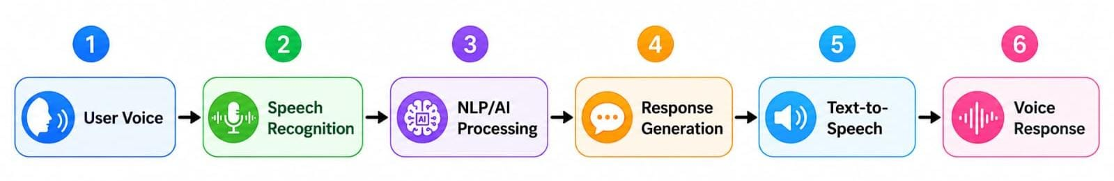
2. Domain Overview
Domain: Artificial Intelligence and Voice Technology
An AI Voice Assistant is a software application that allows users to communicate with a computer using natural speech.
Basic working:
For example:
User: "What is the time now?"
Assistant: Processes the request → obtains time information → speaks the answer.

Slide 4
Technologies involved
Applications
Artificial Intelligence (AI)
Natural Language Processing (NLP)
Speech Recognition / Speech-to-Text
Machine Learning
Large Language Models (LLMs)
Text-to-Speech (TTS)
Python
APIs
Personal assistance
Education
Searching information
Accessibility
Voice-based automation

Slide 5
3. Problem Statement
Traditional computer systems require users to interact using a keyboard, mouse, or touchscreen.
This can create problems for:
People with disabilities
Elderly users
Users who need hands-free operation
Users who are not comfortable typing
Situations where typing is inconvenient
Problem
"How can we develop an intelligent system that allows users to interact with a computer naturally through voice commands and receive quick, understandable responses?"

Slide 6
Proposed Solution
We propose an AI Voice Assistant that:
Listens to the user's voice.
Converts speech into text.
Understands the user's command.
Processes the request using AI/NLP.
Performs the required task or generates an answer.
Converts the answer into speech.
Provides the response to the user.

Slide 7
4. Literature Survey
Source | Author | Publication year | Topic | Main Findings
IEEE | Gowtham J.,Aniket Kumar,Aakash s. | 2023 | Personal Voice Assistants | Voice assistants combine speech recognition, language understanding, dialogue management and speech synthesis. (IEEE Technology Navigator)
IBM | Amanda Downie and Molly Hayes | 2025 | AI Voice Technology | Modern AI voice systems use deep learning, NLP, speech recognition and TTS to create natural voice interactions. (IBM)
AWS | Supriya Puragundla,Mani Khanuja | 2024 | Speech and Voice Agents | Voice agents can combine speech recognition, LLM-based processing and TTS for real-time conversations. (AWS Documentation)
NVIDIA | Vahid Norrozi,Ankush Kumar | 2024 | Speech AI | Speech AI uses automatic speech recognition and text-to-speech for applications such as virtual assistants and accessibility tools. (NVIDIA Developer)
Digital Ocean | James Skelton | 2024 | AI Voice Assistants | AI voice assistants follow a pipeline involving voice capture, speech-to-text, intent understanding, processing, response generation and TTS. (DigitalOcean)

Slide 8
5. Comparative Analysis
We can compare our proposed AI Voice Assistant with traditional interaction systems.
Feature | Traditional System | Basic Voice Assistant | Proposed AI Voice Assistant
Input | Keyboard/Mouse | Voice | Voice
Speech Recognition | ❌ | ✅ | ✅
NLP | Limited/No | Basic | Advanced
Natural Conversation | ❌ | Limited | ✅
Context Understanding | ❌ | Limited | ✅
Text Response | ✅ | ✅ | ✅
Voice Response | ❌ | ✅ | ✅
Task Automation | Limited | Basic | Advanced
Hands-Free Operation | ❌ | ✅ | ✅
Personalization | Low | Medium | High
AI/LLM Integration | ❌ | Sometimes | ✅

Slide 9
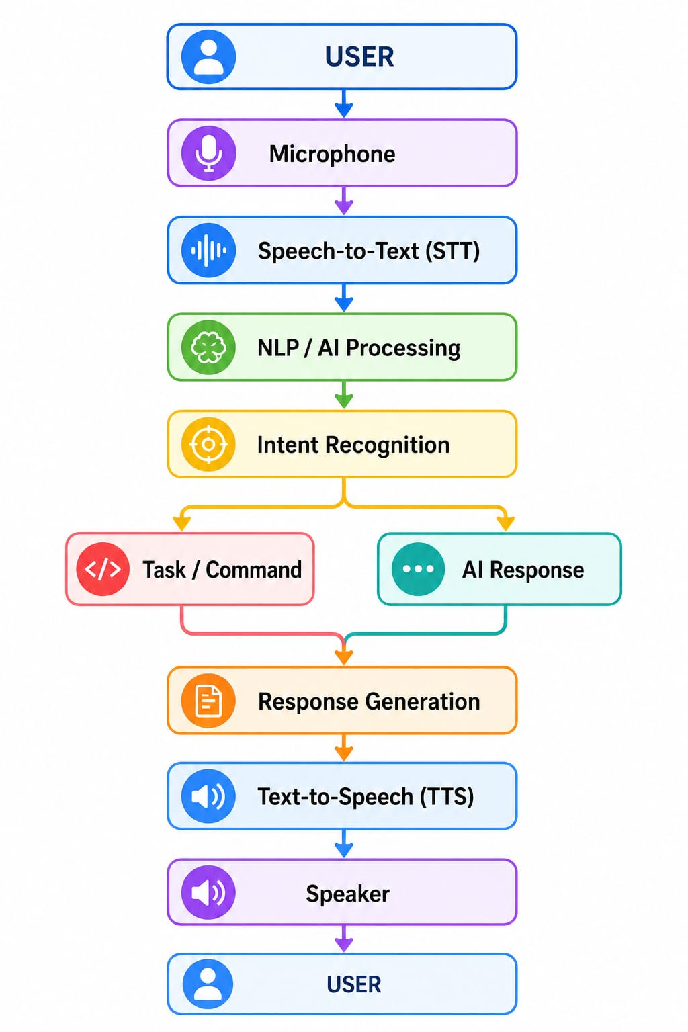
6. Proposed Methodology

Slide 10
Advantages of Proposed System
Easy to use
Hands-free interaction
Natural communication
Faster interaction for simple tasks
Can support multiple languages
Can integrate external APIs
Can be expanded with new skills

Slide 11
Possible Commands
" Open Google."
"Open YouTube."
"Open Chrome."
"Search for Python."
"What is artificial intelligence?"
"Tell me the time."
"Play music."
"Open calculator."
"Open Notepad."
"Exit assistant."

Slide 12
7. Software and Hardware Requirements
Hardware Requirements
Hardware | Minimum Requirement
Processor | Intel Core i3 or equivalent
RAM | 4 GB minimum
Storage | 10 GB free space
Microphone | Required
Speaker/Headphones | Required
Internet | Required for cloud APIs/online AI services

Slide 13
Software Requirements
Software | Purpose
Windows/Linux | Operating System
VS Code | Development Environment
Python | Programming Language
Python Libraries | Voice and AI functions
Speech Recognition API/Library | Speech-to-Text
TTS Library/API | Voice Output
AI/LLM API | Intelligent Responses
Web APIs | External information
Possible Python Libraries
Speech_Recognition
Py.Audio
pyttsx3
requests
datetime
webbrowser
os

Slide 14
8. Timeline
A simple 8-week project plan:
Activity | W1 | W2 | W3 | W4 | W5 | W6 | W7 | W8
Topic Selection | ✓
Literature Survey | ✓ | ✓
Requirement Analysis |  | ✓
System Design |  | ✓ | ✓
Voice Module Development |  |  | ✓ | ✓
AI/NLP Integration |  |  |  | ✓ | ✓
Testing & Debugging |  |  |  |  | ✓ | ✓
Documentation |  |  |  |  |  | ✓ | ✓
Final Presentation |  |  |  |  |  |  |  | ✓

Slide 15
9. Conclusion and Future Scope
Conclusion
The AI Voice Assistant is an intelligent system that allows users to communicate with computers through natural speech.
Speech Recognition + NLP/AI + Task Processing + Text-to-Speech
to provide an interactive and user-friendly experience.
The project demonstrates how Artificial Intelligence can make computer interaction faster, easier, more natural and hands-free.
AI voice technology is increasingly being used in virtual assistants, customer service, accessibility tools, education and other conversational applications.

Slide 16
Future Scope
The project can be improved by adding:
Multilingual support
Voice authentication
Face recognition
Smart home control
Personalized user profiles
Calendar and reminder integration
Email and messaging
IoT device control
Offline voice recognition
Advanced LLM integration
Emotion and sentiment detection
Mobile application
Continuous conversation/memory
Integration with databases and external APIs

Slide 17
References
[1] | Amazon Web Services. (n.d.). Speech and voice agents. AWS Prescriptive Guidance. https://docs.aws.amazon.com/prescriptive-guidance/latest/agentic-ai-patterns/speech-and-voice-agents
[2] | OpenAI. (n.d.). Voice agents: Speech-to-speech and chained voice. OpenAI Developer Documentation. https://developer-openai-com.sitemirror.store/api/docs/guides/voice-agents
[3] | Hugging Face. (n.d.). Creating a voice assistant. Hugging Face Audio Course. https://huggingface.co/learn/audio-course/chapter7/voice-assistant In-text citations

